Slide 1
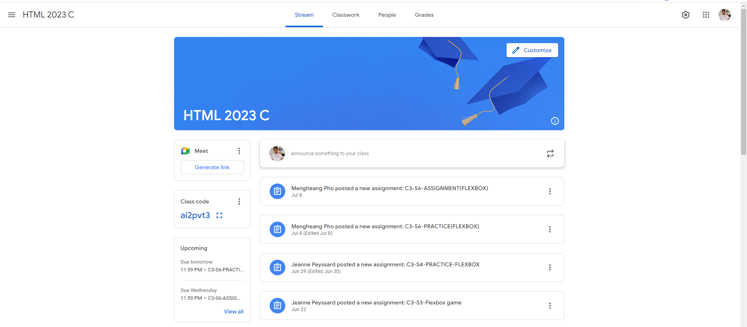
Identify root components of website below

Slide 2
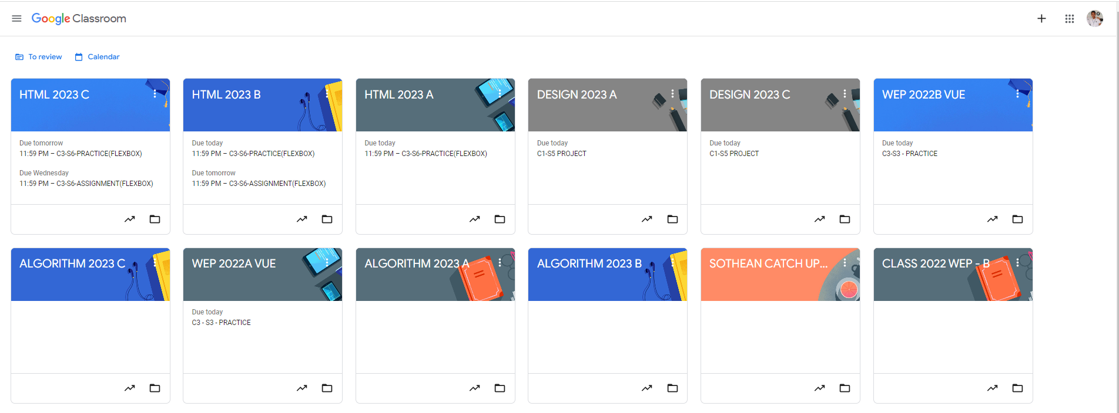
Root div
- Height: 100vh
content
nav
Flex: 0
header
Flex: 0
Flex: 1

Slide 3
NAV BAR
Header
Flex = 1

Slide 4
Container
Flex = 1
NAV
Flex = 1
Flex = 1
Main
Content

Slide 5
Flex = 0
Flex = 0
Flex = 0

Slide 6
Flex = 0
Flex = 0
Flex = 0
Flex = 0
Flex = 0

